Slide 1
Business Unit Review-CADENCE
Feb 1st 2022 | Abhishek Mishra

Slide 2
What is CADENCE?
CADENCE is an internal application that calculates customer risk score, from a money laundering perspective for all ongoing Amex proprietary relationships.
Though, CADENCE started as a Customer risk calculation engine it has since evolved as the system of record for Politically Exposed Persons and KYC refresh elements.
CADENCE drives scheduling of KYC Refresh(KYC)/Customer Due Diligence(CDD)/Enhanced Due Diligence(EDD)/Special PEP Due Diligence(PEP) reviews.
An automatic feed from Bridger to CADENCE facilitates PEP identification & corresponding due diligence.
It is an enterprise-wide tool used by all lines of business across all jurisdictions.
To do all of this, feeds from 30+ systems regularly bring data into CADENCE.

Slide 3
CADENCE Data Sources

Slide 4
CADENCE (cont.)
Four key activities that take place to ensure data is appropriately loaded into CADENCE
(1) Data balancing (2) Transformation/Standardization (3) Hierarchy establishment (4) Customer relationship establishment
Four key activities take place to support the Customer risk assessment
(1) Account risk assessment (2) Hierarchy risk assessment (3) Customer risk assessment (4) PEP risk assessment
Five types of reviews are scheduled to support compliance due diligence.
(1) KYC refresh (2) CDD (3) EDD (4) PEP (5) PRO(Prohibited)
Data Ingestion & Standardization
Risk
Assessment
Review processing

Slide 5
Types of Risk Scores
Account risk score: It the risk score of the account based on Key risk indicators(Product, geography, channel, Industry & structure) of that account only. In simpler words, it is the accounts individual score.
Hierarchy risk score: The highest account risk score of any of the non-closed accounts in the hierarchy, drives the hierarchy score for all accounts in the hierarchy. In simpler words, it is your family score.
Customer risk score: It is the highest hierarchy risk score from any of the non-closed accounts owned by that customer. In other words, this is your personal score.

Slide 6
Customer Risk Score Calculation Example

Slide 7
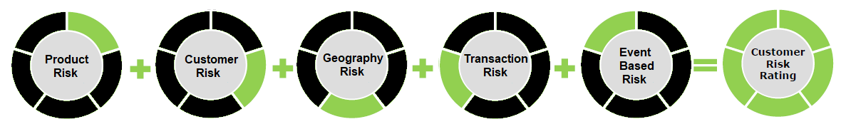
Score Calculation
Roll-up Scoring
In a roll-up scoring model the risk elements are grouped into risk categories. Each risk element is assigned a score based on an analysis of its risk. These element scores, where present for a customer, are then added together to create the score for the risk category. These risk category scores are then simply added together to create a customer risk score.
Risk Categories
Benefits
Allows for better transparency into high risk factors than the decision tree (existing methodology)
Changes are easy to design and implement
Allows for focus to be distributed among the different risk components and not driven by one main risk Category (i.e., Product Risk)
Tuning is flexible during calibration phase because it would involve a simple approach to set up test cases and understand the impact to CRR risk ratings
Considerations
Assumes that all risk elements are scored on a similar scale (i.e., in a range of 1-10 score, a risk element with a score of 9 is 9x riskier than risk elements with score of 1)
Scores may be over-stated if one Category has more risk elements than another Category (e.g., a customer could be rated high risk because all geography risk elements resulted as high risk, but the customer has no high risk products/services or no high risk customer risk elements)

Slide 8
Risk Element example 1
Element Name : Nationality
Market Applicability
= ALL
High/Low Precedence
= HIGH
Weighting Value
= 60
Element Rule
Customers Nationality = India Country Risk = High
Multiplier
Rule Set 1
Result in
1
If Nationality in Medium risk country
OR
Multiplier
Rule Set 2
Result in
2
TRUE
If Nationality in High risk country
Element Score
The risk score for this element is the product of the Weighting Value multiplied by the Multiplier returned from the Rule Set
Multiplier
Weighting Value
60 *
2
= 120
1-Apr-22
AXP Internal
8

Slide 9
Risk Element example 2
Element Name : Foreign ATM transactions in the last 6 months
Market Applicability
= ALL
High/Low Precedence
= HIGH
Weighting Value
= 85
Element Rule
Multiplier
The Customer has 9 ATM transactions in foreign jurisdictions for a total of $9500 across all the accounts owned.
Rule Set 1
Result in
1
Number of foreign ATM transactions > 5
AND
TRUE
Value of foreign ATM transactions > $5000
OR
Multiplier
Rule Set 2
3
Although both Rule Sets are TRUE, the High/Low Precedence will result in the higher Multiplier being used to calculate the Element Score
Result in
Number of foreign ATM transactions > 8
AND
TRUE
Value of foreign ATM transactions > $8000
Element Score
The risk score for this element is the product of the Weighting Value multiplied by the Multiplier returned from the Rule Set
Multiplier
Weighting Value
85 *
3
= 255
1-Apr-22
AXP Internal
9

Slide 10
Risk Element example 3
Element Name : Beneficial Owner in High Risk Geography
Market Applicability
= ALL
High/Low Precedence
= HIGH
Weighting Value
= 30
Element Rule
Multiplier
The Account is a merchant with a beneficial owner who has a home address in the Philippines which has an inherent risk of 7-High
Rule Set 1
Result in
valueof
Product = SE-DIR (direct Merchants)
AND
TRUE
Role = Beneficial Owner
AND
Address usage = Home or Business
AND
Country of Address risk = 7 or 8 or 9
Element Score
The risk score for this element is the product of the Weighting Value multiplied by the Multiplier returned from the Rule Set, which in this rule is the value of the inherent risk of the country
Multiplier
Weighting Value
30 *
7
= 210
1-Apr-22
AXP Internal
10

Slide 11
Final CRR determination
Customer Risk Rating Score
2235
Customer
795
Product
400
Geography
395
Transactions
555
Events
90
PEP
Y
Product Inherent Risk
Med
Domicile of Customer
US
Foreign Wire payments
3
Time since SAR Filed
5 yr
Weighting
400
Weighting
200
Weighting
70
Weighting
100
Weighting
45
Multiplier
1
Multiplier
2
Multiplier
3
Multiplier
3
Multiplier
0
Score
400
Score
400
Score
210
Score
300
Score
0
Length of Relationship
1 yr
High Crime Area
Y
Foreign ATM Trans.
9/$9500
Law Enforcement Inq.
Y
Weighting
25
Weighting
85
Weighting
85
Weighting
90
Multiplier
3
Multiplier
1
Multiplier
3
Multiplier
1
Score
75
Score
85
Score
255
Score
90
Number of Accounts
4
Additional Party Geo
UK
Weighting
50
Weighting
50
Multiplier
4
Multiplier
2.
Score
200
Score
100
Nationality
India
Weighting
60
Multiplier
2
Score
120
1-Apr-22
AXP Internal
11

Slide 12
Risk Class Determination
9
8
7
6
5
4
3
2
1
Enterprise Thresholds
2235 is the calculated score that is then normalized back to the 1 through 9 score, using a threshold scale, as you can see it points to about 4.9 on the 1 through 9 scale, so it is rounded up to 5 Medium
High
3000
2235
These thresholds are initially defined at the enterprise level. However where required local compliance have the ability to create different thresholds for their market.
Medium
1500
Note : The initial thresholds between Low, Medium and High will be determined through testing of the scoring methodology in the sandbox.

Slide 13
Other Important points
Additional Risk Factors (ARF) and High-Risk Overrides(HRO)
ARFs exist today externally from the core of the risk assessment and apply overrides to the score once it is calculated. Either +1 +2 or +3, but these are not cumulative. In the new methodology, these additional rules can be created as risk elements in the relevant risk category and can now carry any weight based on the value assigned and now will be cumulative.
HROs always set the risk score to 9-High. They are also external rules, The new methodology will continue to create these externally in the same way, but has the ability to include them in the single scoring scheme by assigning a large enough value to cross the threshold for High Risk.
Customer based view of the data
The risk scoring methodology will consider the customers relationships holistically during the risk calculation. Today each account owned by the customer is score independently and then the highest of those risk scores is assigned to the customer. The new approach would be to use all the data from all the customer accounts to calculate the score.
Prohibited Geographies
Where a prohibited Geography exists on an account, the customer score will still be calculated, but it will be normalized to a risk rating of 10 – Prohibited

Slide 14
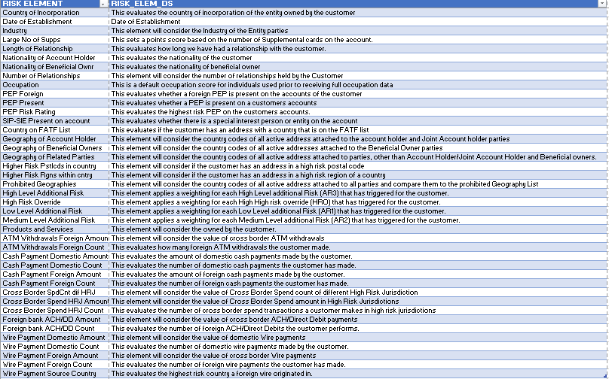
Data elements as of Feb 2022

Slide 15
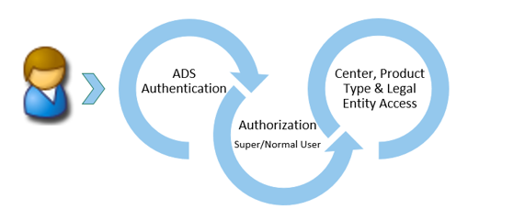
User Access Control
User access as depicted above is driven by Market, product type & issuing Amex legal entity and requires leader’s approval.

Slide 16
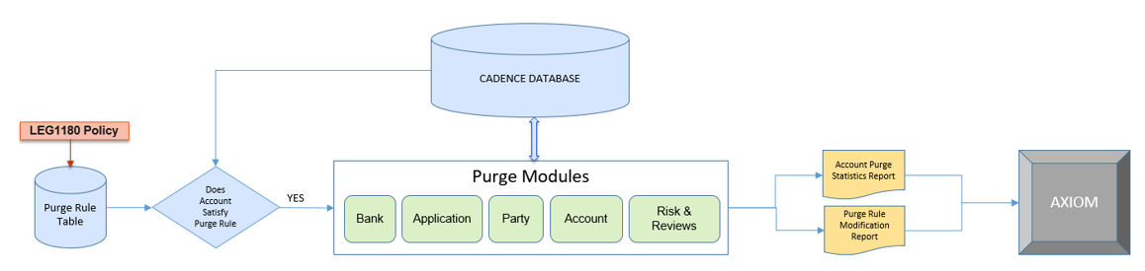
CADENCE Purge Architecture
LEG1180 is internal Government Compliance and Reporting - Anti-Money Laundering platform data retention policy.
Facilitate the retention, protection, and proper disposition of all records to comply with legal and regulatory requirements for local market record retention.

Slide 17
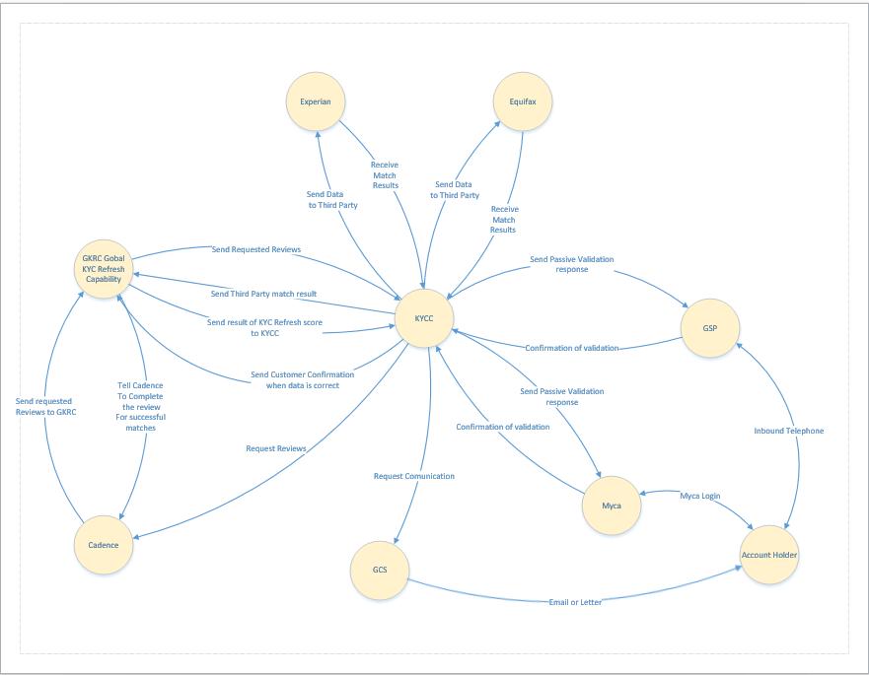
KYCC-GKRC-CADENCE Architecture - POA
1)CADENCE schedules & stores the reviews.
2)GKRC distributes the reviews and calculates the KYC refresh score by using weighing of the verified KYC fields. The weightage of fields and thresholds may vary by market.
In the US there are 4 fields included in the KYC refresh score
Name 30 points, if verified.
Address 30 points, if verified.
DOB 20 points, if verified.
SSN 20 points, if verified.
To pass KYC refresh, total of verified fields must exceed 79.
GFCC owned
Distributed
2
1
Mainframe

Slide 18
Appendix

Slide 19
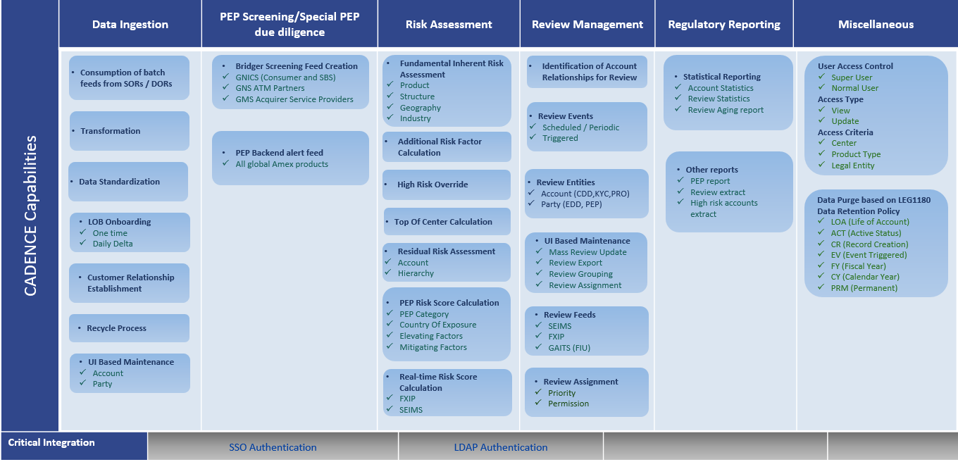
CADENCE Capabilities

Slide 20
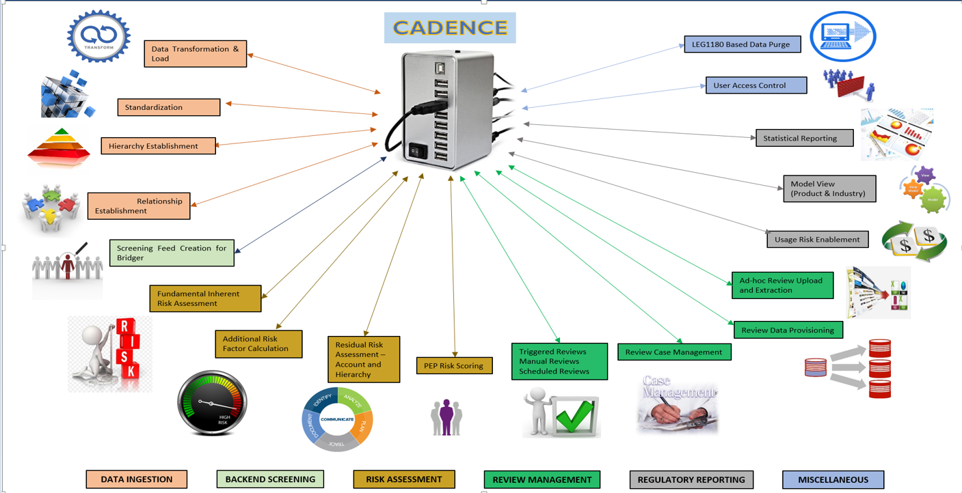
CADENCE Capabilities (cont.)

Slide 21
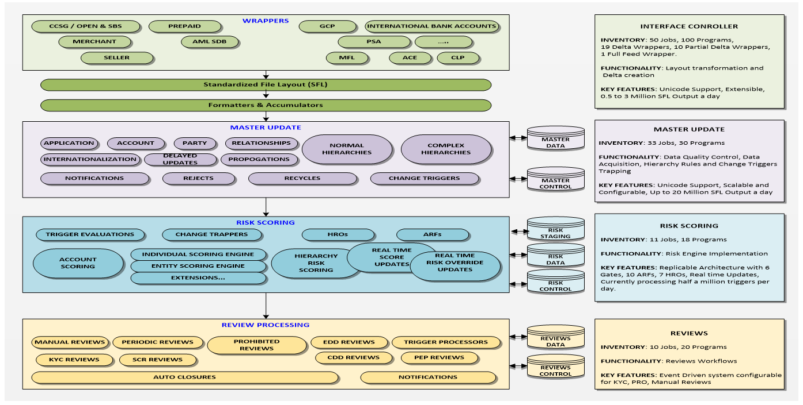
CADENCE Solution Architecture

